Slide 1
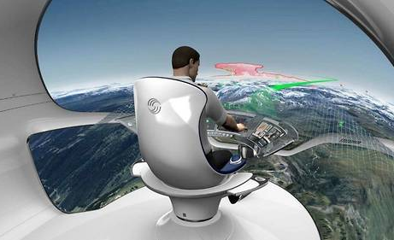
Planning and Scheduling for On-Board Aerospace Applications: from safety to resilience
Guettier Christophe and Henry Edith
name.surname@safrangroup.com

Slide 2
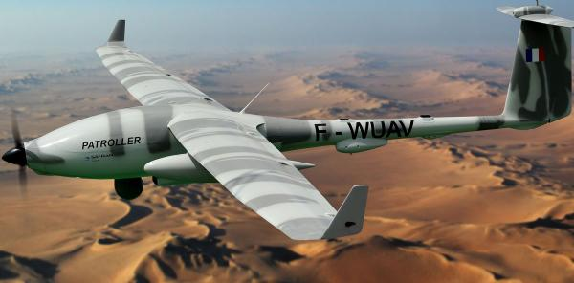
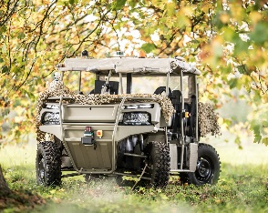
Autonomous System Context
Known and mastered environment
Full controlability
Partially known environment
Long term uncertainty
Unknown environment
Short term uncertainty and contingencies
Automata
Autonomous Control
Planning for mobility
Automatic System Scheduling
Planning and scheduling for mission
Separate validation, global certification
System level verification, validation, certification?

Slide 3
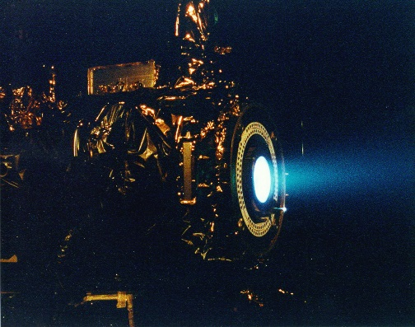
Classic Engineering: Finite State Automata
Example sketch of a propulsion system
Burst
After-burner
Safe-mode
Emergency
Cool-down
Current practice
Finite state automaton
Determinist
Reactive
Avoid Parallel States
Temperature vs Thrust
SAFRAN Ion Drive
Reset
Thrust
After Burner
Certification conditions
Safe
Cool Down
=> Real time, instantaneous « control » Horizon

Slide 4
Autonomous Control
Cf. Anytime Behaviour of Mixed CSP Solving
N Yorke-Smith, C Guettier (2004)
Warning Alarm
Heat
Boost
T°>Tmax
Boost
Heat
CoolDown
Reset
Non controlable disjunctions
Normal Temp
T°=<T^{max}
Thrust Choice
Alarm
False Alarm
System control
T°<T^{max}
Emergency cool down
Environment control
Nominal temp
Nominal thrust
T°<T^{nominal}
Cool Down
Reset
Extensions to model based diagnosis
Constraint violation on current state => diagnosis
Constraint violation on future state => Predictive diagnosis
T°<T^{nominal}
Reseting
=> Short term « control » Horizon, fail safe
Other modelling approaches to investigate: PDDL2.2, DTNU

Slide 5
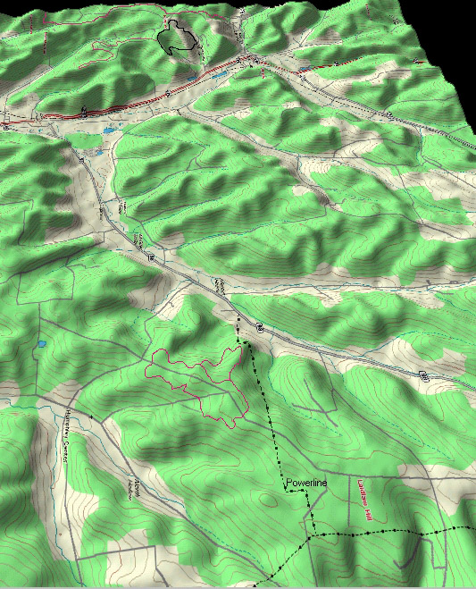
P&S for Mobility and Mission
Solving:
A*, D*Lite,
Dedicated Constraint Solving
Phase transition pattern
Input:
Mission Start and End or Initial / Final Conditions (resourcs, state)
Terrain Structure: Navigation graph of possible WayPoints
On board resource consumption
Observations actions set to perform, with timing, exposure and resource conditions
Output
Navigation plans
Actions that can be realised
Observation Areas
O₁
O₂
Action structure:
Precondition:
At Position, Speed, Time
On-Board Resources Status
Post condition:
Time
Effect (information acquired?)
On-Board Resources consumption
O₃
O₄
Recovery Point
Starting point
=> Long term Horizon
Preconditions with uncertain variables
Disjunctive post conditions
Resilience level:
Unsafe plans =>
Fail « operational »

Slide 6
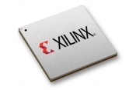
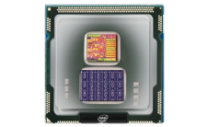
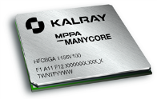
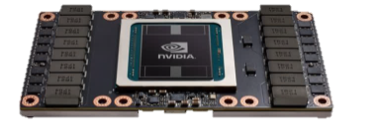
Integration, Verification, Validation and Certification and AI Tensions
V&V
IV&V SW
IVQ SW+HW
AI Planning Algorithms
1
AI Strategy
Logical inference, SAT, constraint solving, CSAT
Search
(meta)Heuristics
Domain-independent heuristics
Domain heuristics
Models
Data
Hybridation
Agent based architecture
Autonomous
Interactive (speech,…)
Cooperative, Collaborative
Distributed
FPGA
2
A* and extensions (D*, D*Lite,…), other planning algorithms,
Specifics?
CPU, MultiCPU, MIMD
Probabilist Planning (POMDP)
3
GPU
Combinatorial explosion, Global representations / models
Behaviorial
Sizing / Compilation

Slide 7
Conclusion
IVQ and Certification methodology
Bound the functional domain over a given horizon (temperature, flight enveloppe)
Address Model Predictive Control
How to adapt existing methodologies to P&S implementations for certified application
Live testing, dynamic validation approach?
Certification also needs to address learning stages → how to perform a test drive?
Combine several planners with different functionalites
Need segregated architectures
Redundant with disymetric architectures (both functional and structural) → needs for comparable performances!
Opportunities for failure diagnosis and prognostic
Which hardware shall be used?
FPGA is more adequate to certification processes,
For CPU/GPU, how to address OS issues related to support of planning functionalities

