Slide 1
Reinforcement Learning for Zone Based Multiagent Pathfinding Under Uncertainty
Jiajing Ling, Tarun Gupta, Akshat Kumar
School of Information Systems
Singapore Management University

Slide 2
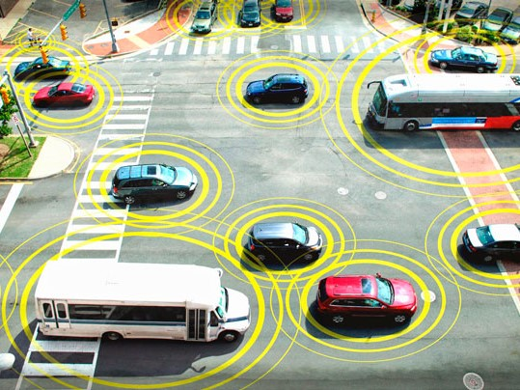
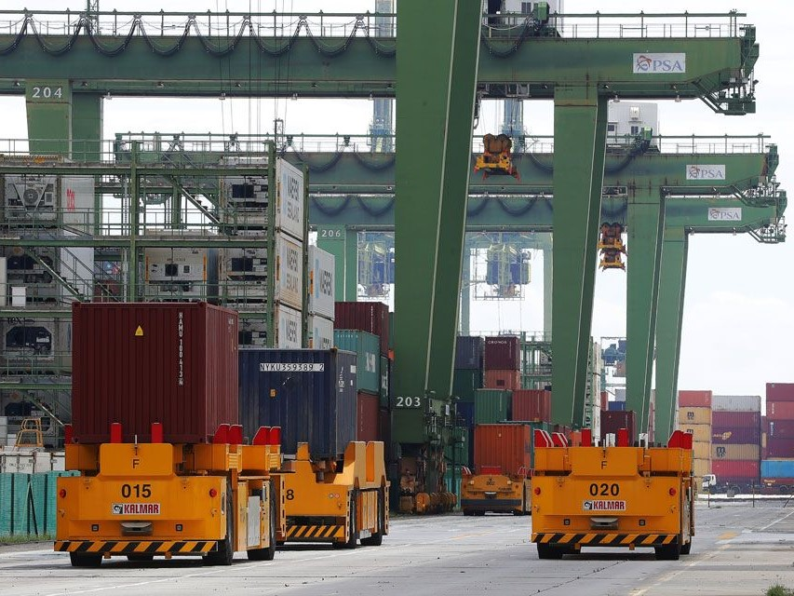
Motivation
Autonomous Car
Autonomous Guided Car
Autonomous Drone
How to coordinate autonomous vehicle movements in a partially observable environment with uncertainty?

Slide 3
Our contributions
We formulated a zone based path finding problem. (ZBPF)
Under uncertainty
Partial Observability
We presented a novel formulation of policy optimization.
Based on difference-of-convex functions (DC) programming
We developed a simulator for ZBPF using Unity3D.

Slide 4
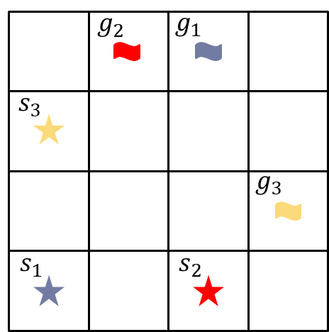
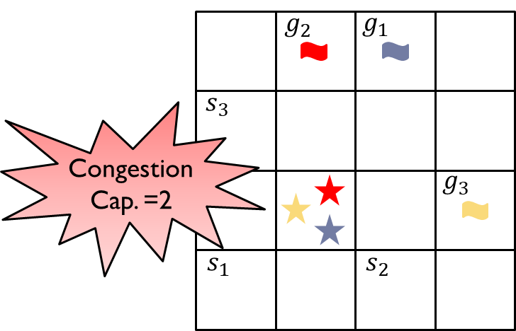
Problem formulation
A graph $G=\left(V,E\right)$
A set of agents with sources and destinations
Each zone has a capacity. Agents consume some capacity
Crossing two zones requires minimum and maximum time
Objective: Minimize travel time and congestion

Slide 5
Our Simulator
Simulator: Unity3D environment
The spheres are the zones, and cubes are the agents.
Highlighted zone: there is congestion
Highlighted agent: reached destination

Slide 6
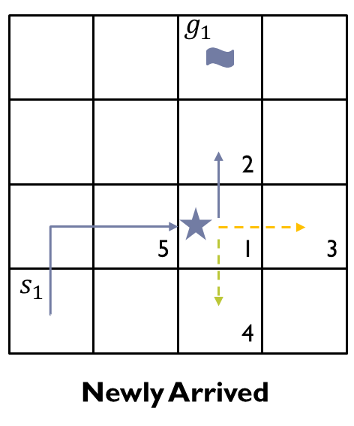
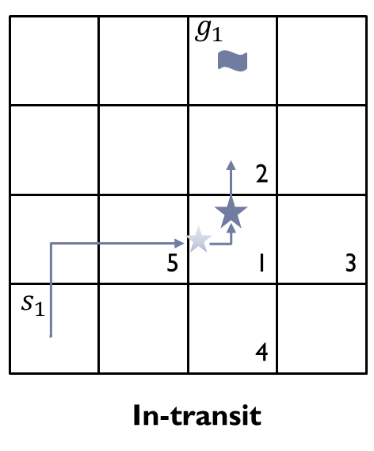
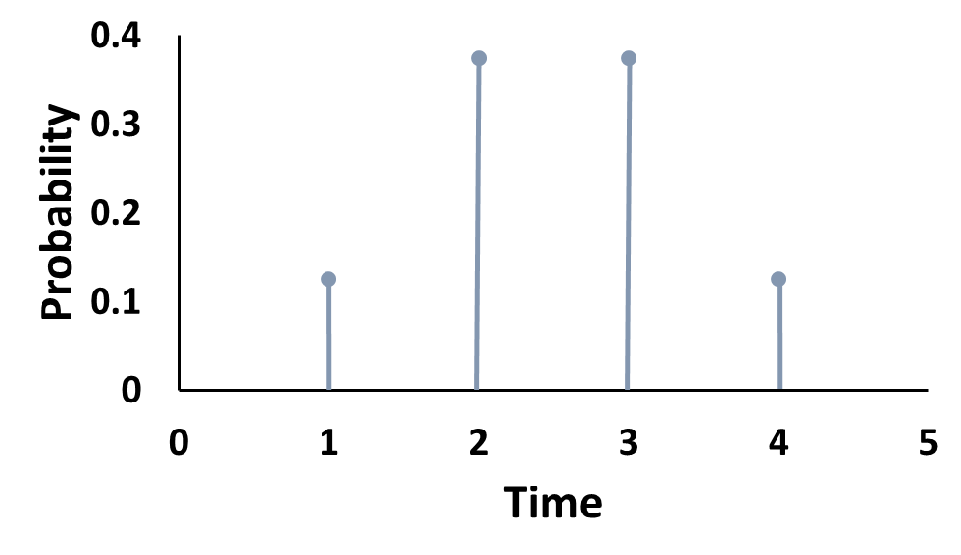
Agent’s Decision Model
State
A tuple $\left\langle current zone\right.,next zone,\left.remaining time\right\rangle$
If newly arrived, e.g., $\left\langle z_{1}\right., Φ, \left.Φ\right\rangle$ ; If in-transit, e.g., $\left\langle z_{1}\right., z_{2}, \left.1\right\rangle$
Hybrid Action (discrete, and continuous)
If newly arrived, e.g.,$\left\langle z_{2}\right., \left.ν=0.5\right\rangle$; If in-transit, $noop$
$$Travel Time Sampling$$
$ν=0.5$ (continuous action)
$t_{min}=1$, $t_{max}=$4

Slide 7
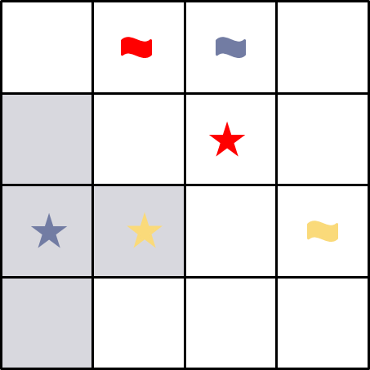
Agent’s Decision Model
Transition Function (exponential family)
$p\left(s^{′i} | s^{i},a^{i},ν^{i}\right)=f\left(s^{i},a^{i},s^{′i}\right)\exp{\{ν^{i}φ\left(s^{i}, s^{′i}\right)−𝒜(ν^{i})\}}$
Uncertainty movement can be modeled
Applicable in several applications
Partial Observation
Only local neighboring zones
Reward Function
A positive reward for reaching the goal
A negative reward for time step or congestion

Slide 8
Policy Optimization in DC Form
Original Objective Function
$J\left(π,μ\right)=\sum_{ς}{p\left(ς\right)G(ς)}$
Why DC programming?
The objective is non-linear, nonconvex. Direct opt. is difficult.
Nonlinear solvers cannot scale to large number of agents.
$\min{\{u\left(x\right)−v\left(x\right) :x∈Ω\}}$
$u\left(x\right)$ and $v(x)$ are convex functions
Concave-Convex Procedure (CCP) can solve it iteratively.
DC Programming
$$x_{k+1}=argimin\{u\left(x\right)−x^{T}∇v\left(x_{k}\right) :x∈Ω\}$$

Slide 9
Policy Optimization in DC Form
Objective Function in CCP
$$\max_{π,μ}{𝔼\left[Q^{k}\left(s,a,ν\right)\left(\sum_{i=1}^{N}{\log{π^{i}}\left(a^{i} | s^{i},y^{i}\right)}\right)\right]+γ𝔼\left[Q^{k}\left(s^{′},a^{′},ν^{′}\right)\left(\left(\sum_{i=1}^{N}{φ\left(s^{′},s^{′i}\right)μ^{i}\left(a^{i},s^{i},y^{i}\right)}\right)−\left(\sum_{i=1}^{N}{A\left(μ^{i}\left(a^{i},s^{i},y^{i}\right)\right)}\right)\right)\right]}$$
fixed
concave
fixed
linear
concave
Planning
With known model
Get a better policy $π_{k+1}$ and $μ_{k+1}$ iteratively
General nonlinear solver can be used to optimize it
Leraning
Model-free setting
Assume parameterized policy $π_{θ}$ and $μ_{θ}$
Multiagent credit assignment
What is the contribution of an agent to the team reward?
Low variance gradient estimates
NN-Based policy

Slide 10
Experiments
2D Open Grid
4x4 grid, 2 agents to 10x10 grid, 10 agents
Starting and goal locations were the top and bottom rows
The capacity was sampled uniformly from a range, e.g., [1,4].
$t_{min}=1$, $t_{max}=$5 (binomial distribution as travel time dist.)
Comparison against
SP (each agent follows shortest path)
DCRL (our approach)
VPG (vanilla Policy Gradient)
HA (multiagent Q-learning based for hybrid action space)

Slide 11
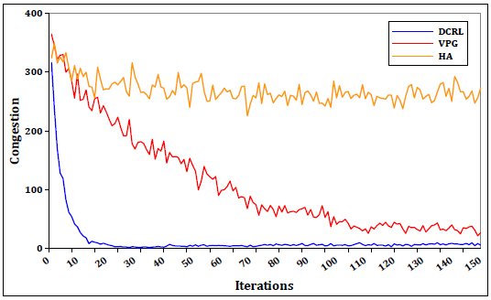
Experiments: 2D Open Grid
VPG suffers due to lack of effective credit assignment
HA isn’t able to handle a large number of agents

Slide 12
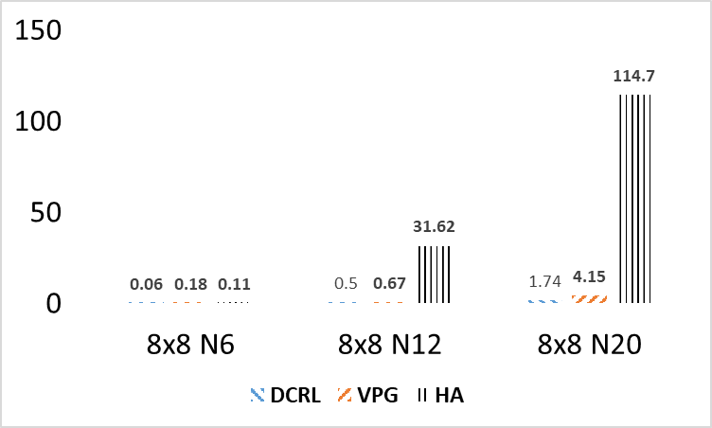
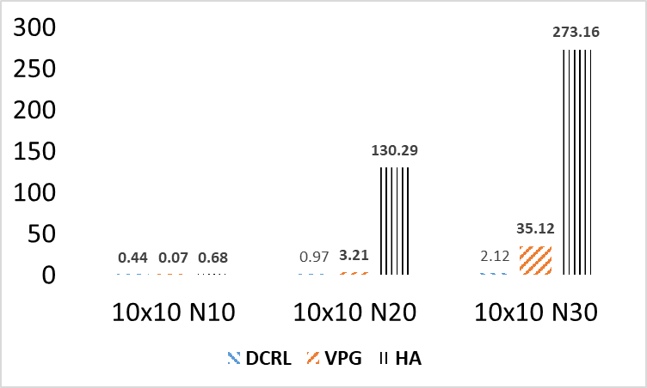
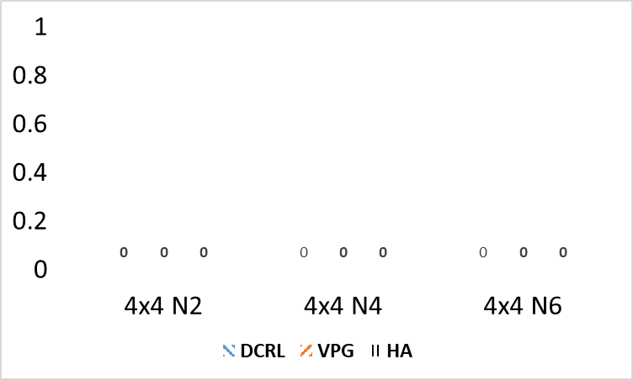
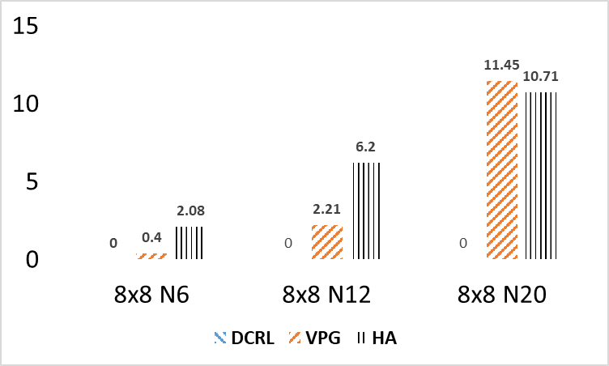
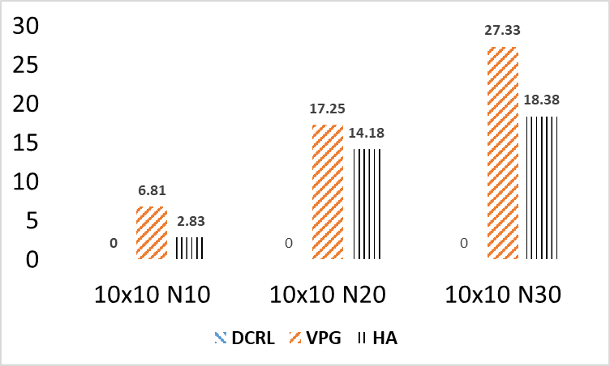
Experiments: 2D Open Grid
Congestion
Stranded Agents

Slide 13
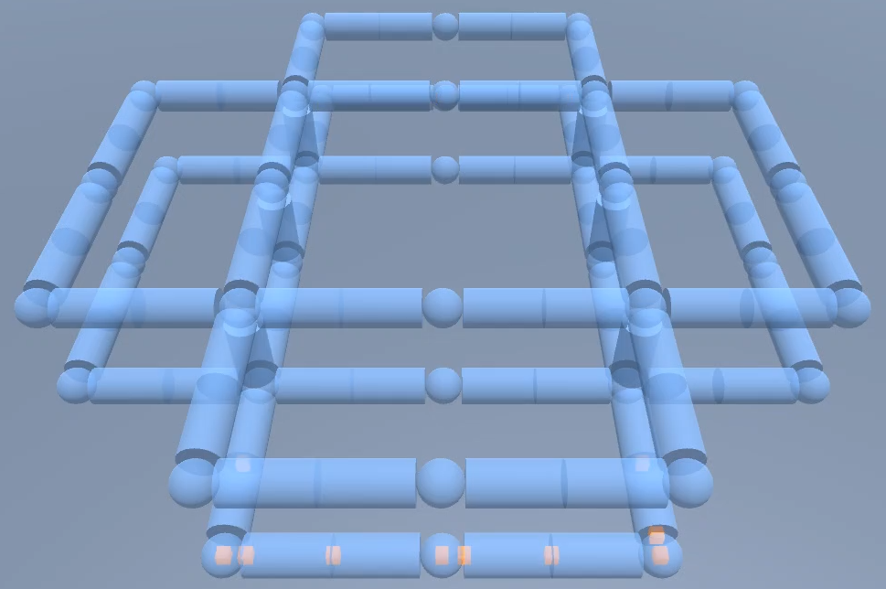
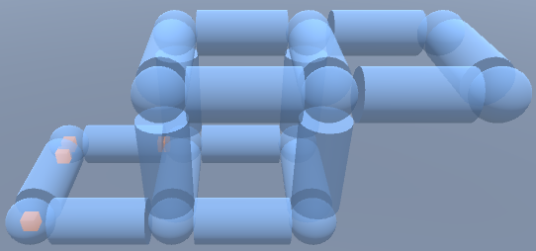
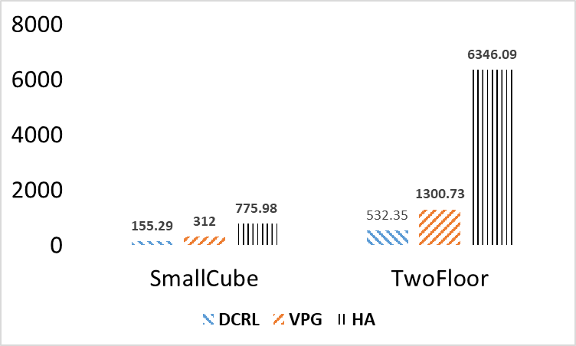
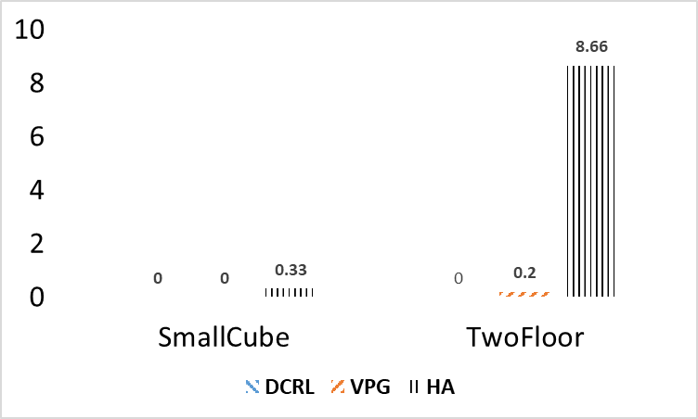
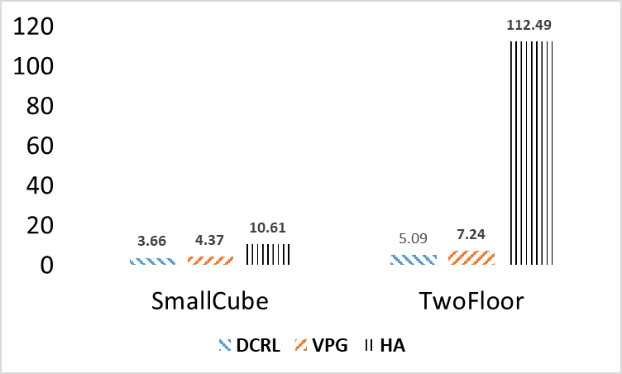
Experiments: 3D Map
Settings:
10, 20 agents for SmallCube and TwoFloor
Capacity was sampled from [1,3] and [1,4]
Results:
SOC
Stranded Agents
Congestion

Slide 14
Summary
We addressed the problem of ZBPF under uncertainty.
We have developed a simulator.
2D and 3D
We presented a novel policy optimization formulation.
Based on DC programming (for both planning and learning)
Designed a credit assignment scheme
Our approach works much better than baselines.

